Slide 1
Auto moderation of images
Using algorithmic (non-machine learning) solutions to current manual moderation of images

Slide 2
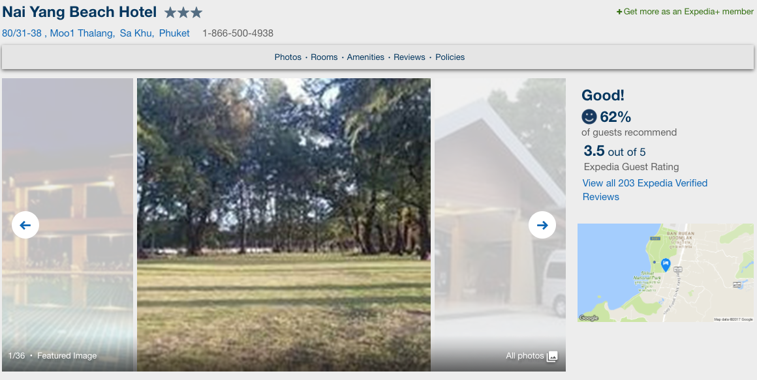
Currently Expedia low quality images (ex.Blur)

Slide 3
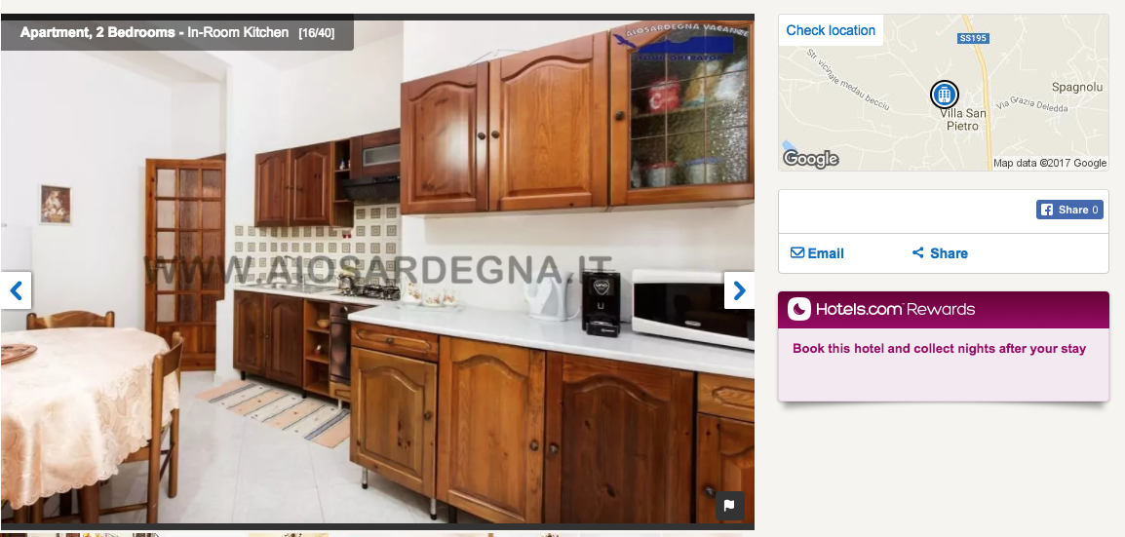
Hotels also shares these images (ex.Text)

Slide 4
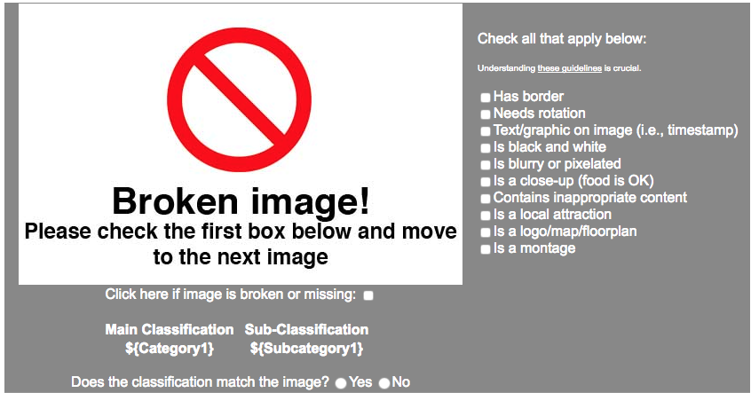
Current Moderation: Mechanical Turk

Slide 5
Mechanical Turk: Limitations
Cost: 2 cents per image
Only new EPC images are targeted by the manual moderation
Some images are false positives (we rely on a single turker)
Some moderation tasks can be automated
Only detection of problems

Slide 6
Algorithms vs Machine Learning
Algorithms | Machine Learning
Border detection
 | Rotation
Text
Black and White (Grayscale)
Blurry or Pixelated
 | Close up (food is OK)
 | Inappropriate content
 | Local attraction
Logo/Map/Floorplan
 | Montage

Slide 7
Demo

Slide 8
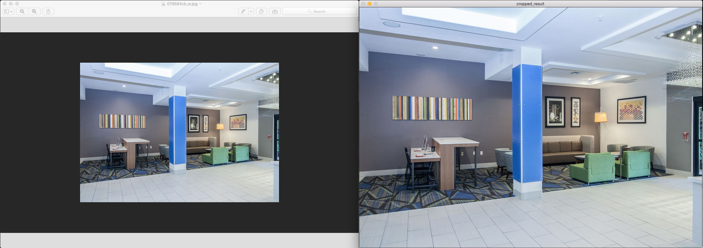
Automatic Cropping (detect and fix)

Slide 9
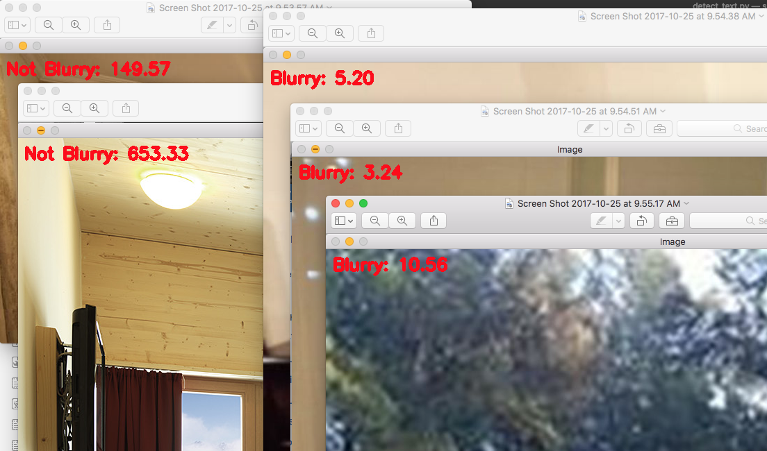
Blur Detection

Slide 10
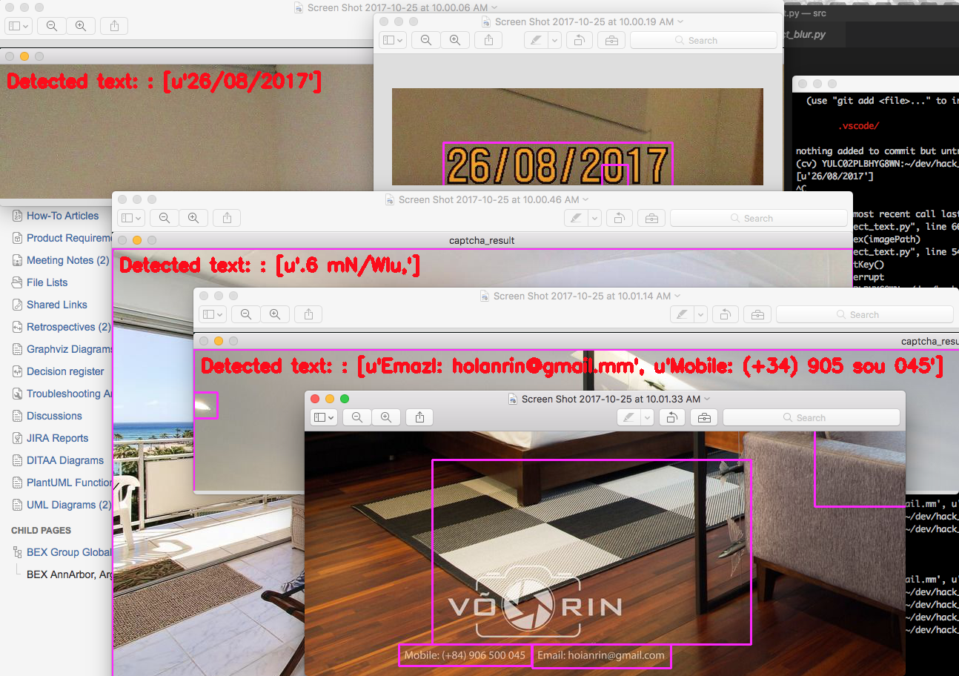
Text detection

Slide 11
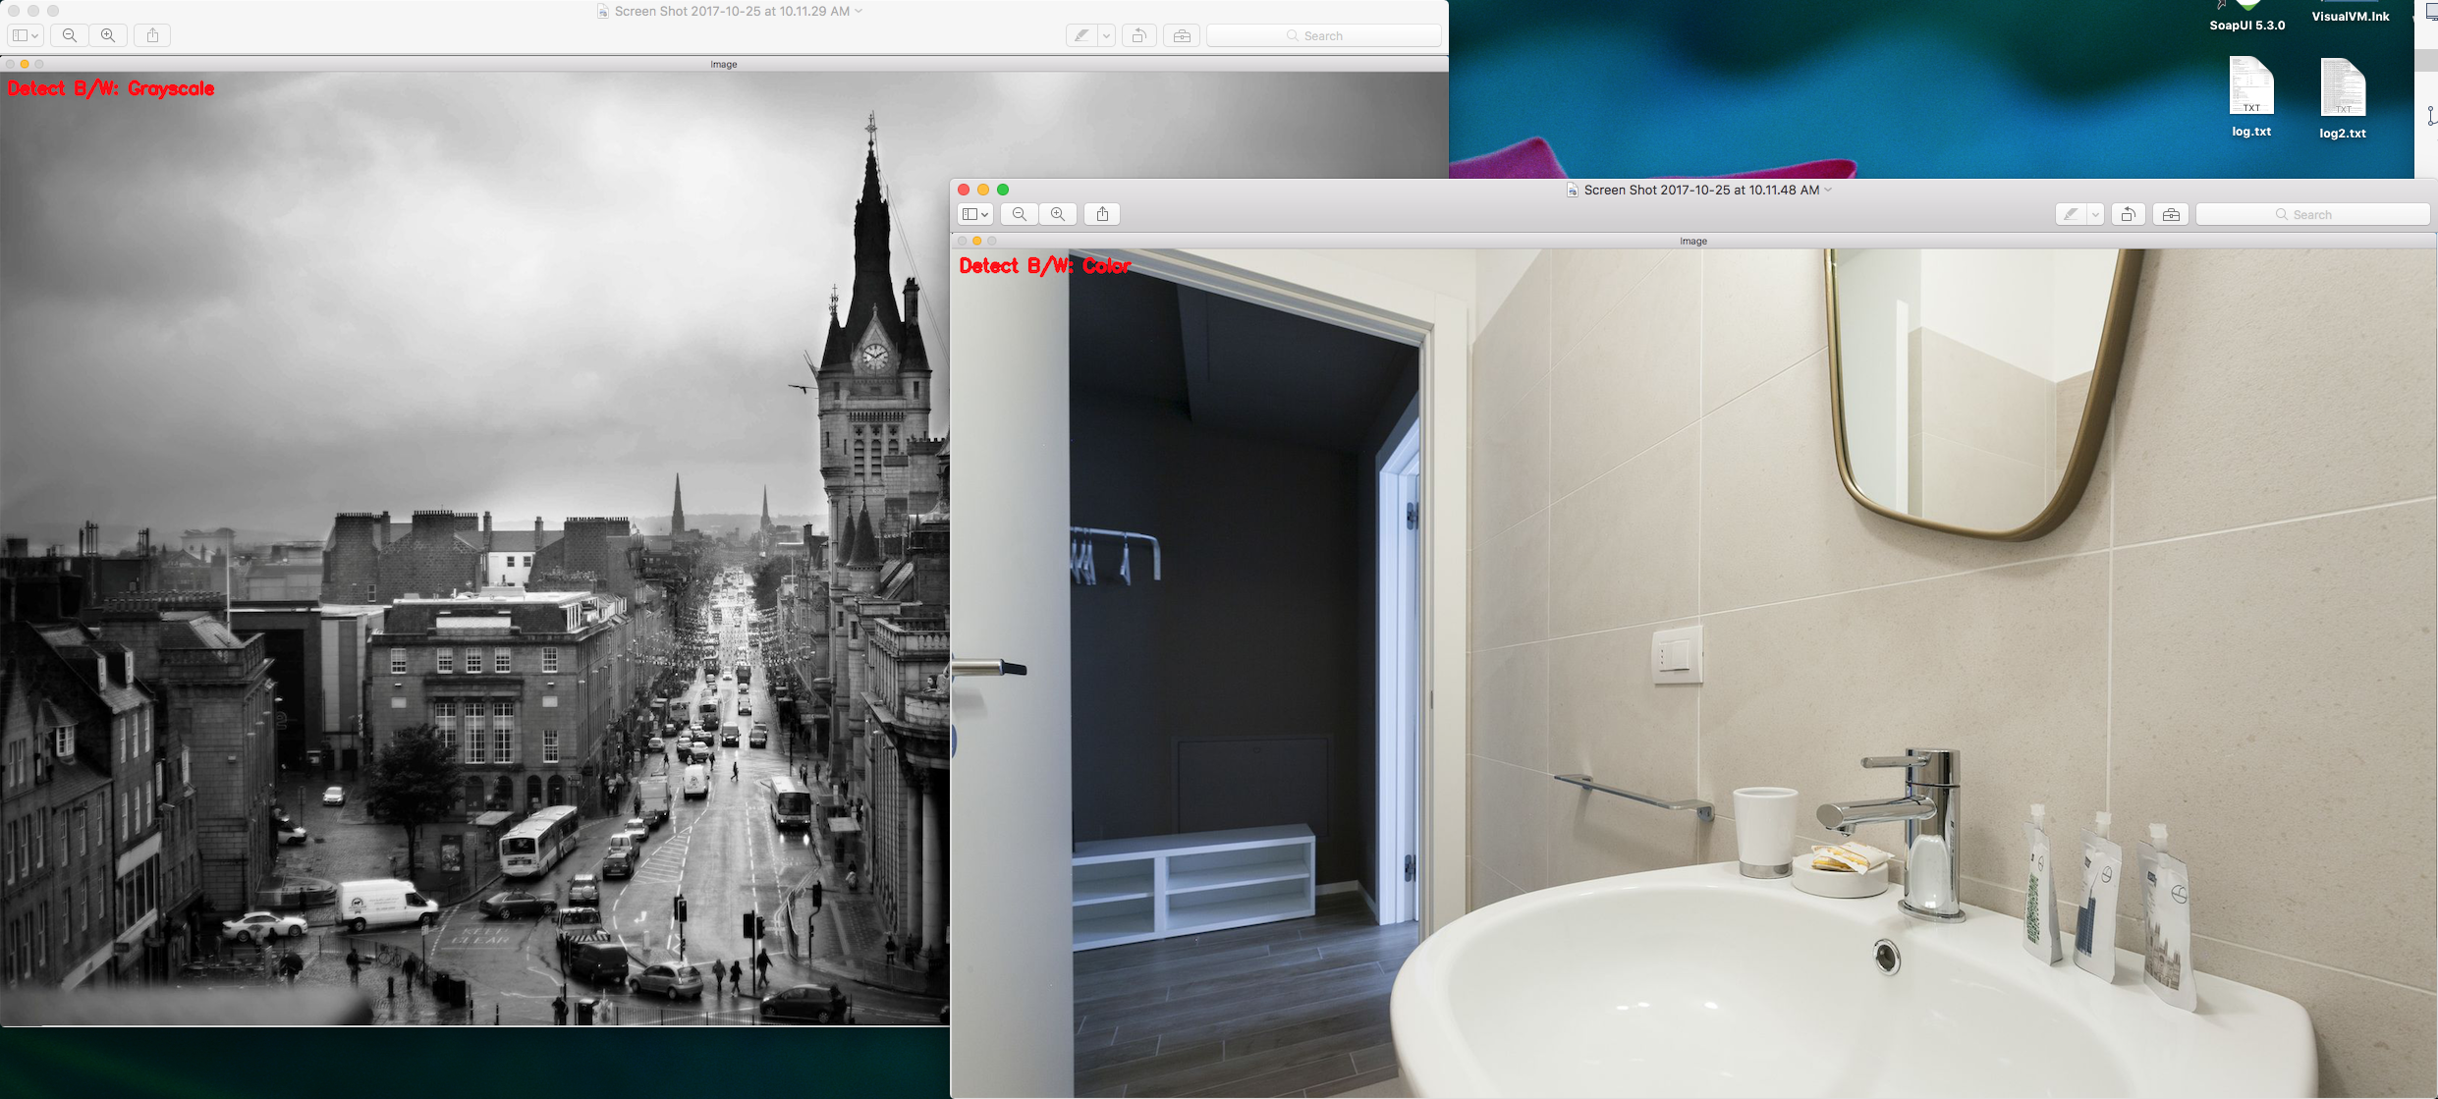
Black and White detection

Slide 12
Q&A

